Slide 1
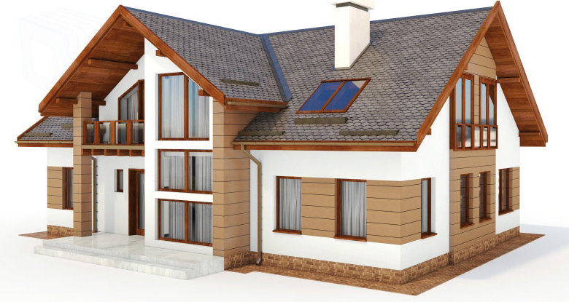
Use – Case : 3D House
Prepared by : Santosh Ahirrao

Slide 2
3D House
Objective : For a user input address build 3D house/building
Data available : DSM (Digital Surface Map) and DTM (Digital Terrain Map) along with other supporting file.
Process:
Serial No | Task
1 | Project Understanding
2 | Preparation
3 | File input
4 | Tiff working
5 | 3D

Slide 3

3D House
Challenges :
Due to lack of uniform width and height for tiffs, data frame cannot be prepared manually for all tif files. All tif need to processed at least once to form smaller tiled tif and to store the data frame for metadata.
Width
Height

Slide 4
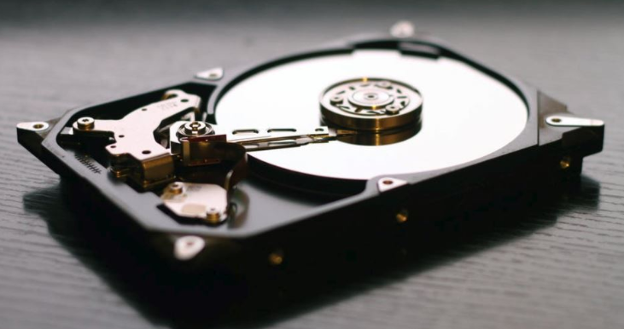
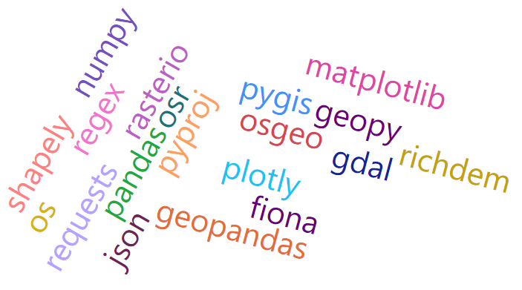
Huge storage required to store all files. So worked on K15, K10, K1
3) Packages to be used.

Slide 5
Sample Output of the code :
Francis Wellesplein 1, 2018 Antwerpen
Leopold de Waelplaats 22, 2000 Antwerpen
Leopold de Waelplaats 22, 2000 Antwerpen
Tavernierkaai 3, 2000 Antwerpen

Slide 6
Improvement Required in existing Code
Need to develop code for auto download all zip available on url.
Need to add exception handling for wrong address entered.
The tile finding process should be such that, first need to identify the bigger tif, then should go to specific
folder only.
4) Need to develop it for the address which lies on the multiple tif.

Slide 7

Thank You

